Slide 1
STOCK MARKET ANALYSIS AND PREDICTION USING ARTIFICIAL NEURAL NETWORK

Slide 2
ABSTRACT
In this project we attempt to implement an Artificial Neural Network approach to predict stock market prices. Artificial Neural networks are very effectively implemented in forecasting stock prices, returns, and stock modeling, and the most frequent methodology is the Backpropagation algorithm. We outline the design of the Neural Network model with its salient features and customizable parameters. We select a certain group of parameters with relatively significant impact on the share price of a company. With the help of statistical analysis, the relation between the selected factors and share price is formulated which can help in forecasting accurate results. Although, share market can never be predicted, due to its vague domain, this project aims at applying Artificial Neural Network in forecasting the stock prices.

Slide 3
TABLE OF CONTENTS
(1) ABSTRACT
(2) INTRODUCTION
2.1 Objective
(3) LITERATURE REVIEW
3.1. Relevant Works
(4) METHODOLOGY
4.1. Data Sources
4.2. Data Set Creation and Normalization
4.3. Activation Function
4.4. ANN Design and Training
4.5.Training Parameters
4.6. Backpropagation and feed-forward neural network
(5) REFRENCES
(6) DELIVERABLE TARGETS

Slide 4
INTRODUCTION ABOUT OBJECTIVE
Stock market is very vast and difficult to understand. It is considered too uncertain to be predictable due to huge fluctuation of the market. Stock market prediction task is interesting as well as divides researchers and academics into two groups, those who believe that we can devise mechanisms to predict the market and those who believe that the market is efficient and whenever new information comes up the market absorbs it by correcting itself, thus there is no space for prediction.
Investing in a good stock but at a bad time can have disastrous result, while investing in a stock at the right time can bear profits. Financial investors of today are facing this problem of trading as they do not properly understand as to which stocks to buy or which stocks to sell in order to get optimum result. So, the purposed project will reduce the problem with suitable accuracy faced in such real time scenario.

Slide 5
OBJECTIVES: The aims of this project are as follows: ▪ To identify factors affecting share market ▪ To generate the pattern from large set of data of stock market for prediction of NEPSE ▪ To predict an approximate value of share price

Slide 6
LITERATURE SURVEY
In the last few decades forecasting of stock returns has become an important field of research. In most of the cases the researchers had attempted to establish a linear relationship between the input macroeconomic variables and the stock returns. After the discovery of nonlinearity in the stock market index returns, many literatures have come up in nonlinear statistical modeling of the stock returns, most of them required that the nonlinear model be specified before the estimation is done. Some researchers used input data from a single time series where others considered the inclusion of heterogeneous market information and macro-economic variables. Some researchers even preprocessed these input data sets before feeding it to the ANN for forecasting.

Slide 7
.
RELEVANT WORKS
Wilson and Sharda studied prediction firm bankruptcy using neural networks and classical multiple discriminant analysis, where neural networks performed significantly better than multiple discriminant analysis.
Min and Lee were doing prediction of bankruptcy using machine learning. They evaluated methods based on Support Vector Machine, multiple discriminant analysis, logistic regression analysis, and three-layer fully connected back-propagation neural networks. Their results indicated that support vector machines outperformed other approaches.
Lee was trying to predict credit rating of a company using support vector machines. They used various financial indicator and ratios such as interest coverage ratio, ordinary income to total assets, Net income to stakeholders’ equity, current liabilities ratio, etc. and achieved accuracy of around 60%. Predicting credit rating of the companies were also studied using neural networks achieving accuracy between 75% and 80% for the United States and Taiwan markets.
Tsai and Wang [2] did a research where they tried to predict stock prices by using ensemble learning, composed of decision trees and artificial neural networks. They created dataset from Taiwanese stock market data, taking into account fundamental indexes, technical indexes, and macroeconomic indexes. The performance of Decision Tree + Artificial Neural Network trained on Taiwan stock exchange data showed Fscore performance of 77%. Single algorithms showed F-score performance up to 67%.

Slide 8
Kim and Han [3] used a genetic algorithm to transform continuous input values into discrete ones. The genetic algorithm was used to reduce the complexity of the feature space. This paper proposes a novel evolutionary computing method called a genetic quantum algorithm. Genetic Quantum Algorithm is based on the concept and principles of quantum computing such as qubits and superposition of states. Instead of binary, numeric, or symbolic representation, by adopting bit chromosome as a representation Genetic Quantum Algorithm can represent a linear superposition of solutions due to its probabilistic representation. As genetic operators, quantum gates are employed for the search of the best solution.

Slide 9
METHODOLOGY
The purposed method for developing the system consists of mainly three main steps. Firstly, data is collected and sorted for relevancy from various sources. Secondly, analysis is carried out on the collected data by examining the current market direction, tracking the industry group and specific companies after which the data is represented and scored accordingly. At last, an ANN is designed and a suitable algorithm yielding best accuracy is chosen to predict the stock value.

Slide 10
Data Sources This project attempts to predict the stock value with respect to the stock’s previous value and trends. It requires historic data of stock market as the project also emphasizes on data mining techniques. So, it is necessary to have a trusted source having relevant and necessary data required for the prediction. We will use Opening value, Closing value, Highest value, Lowest value, number of shares, increase or decrease in stock values for each financial companies The main problem in predicting share market is that the share market is a chaos system. There are many variables that could affect the share market directly or indirectly. There are no significant relations between the variables and the price. We cannot draw any mathematical relation among the variables. There are no laws of predicting the share price using these variables.

Slide 11
For this kind of chaotic system the neural network approach is suitable because we do not have to understand the solution. This is a major advantage of neural network approaches. On the other hand in the traditional techniques we must understand the inputs, the algorithms and the outputs in great detail. With the neural network we just need to simply show the correct output for the given inputs. With sufficient amount of training, the network will mimic the function. Another advantage of neural network is that during the tanning process, the network will learn to ignore any inputs that don’t contribute to the output. In our purposed system, there is a training phase where some parameters named weights are found from this section and Backpropagation Algorithm is used for this training phase. These weights are used in prediction phase using same equations which are used in training phase.

Slide 12

Dataset Creation First of all, a dataset is created for training the Artificial neural network. The collected data are arranged according to the format for the library we use for training. The dataset should be of exact format that FANN specifies. It includes number of training pair, number of input and number of output in the first line of the dataset file and data from the second line. Data Normalization The data is normalized before being input to the ANN. The input vectors of the training data are normalized such that all the features are zero-mean and unit variance. The target values are normalized using minmax function such that all the values are converted into the values within the range of 0 to 1. The minimum value is represented by 0 and the maximum value is represented by 1.

Slide 13

Activation Function
We use log sigmoid function as the activation function at both hidden layer and output layer. A sigmoid function is a mathematical function having a characteristic "S“ shaped curve or sigmoid curve which is given by:
It transforms linear inputs to nonlinear outputs. It bounds output to between 0 and 1 so that it can be interpreted as a probability and it also makes computation easier than arbitrary activation functions. The reason we choose this function as activation function is because it gives logistic neurons real-valued output that is a smooth and bounded function of their total input. It also has the added benefit of having nice derivatives which make learning the weights of a neural network easier.

Slide 14
Training Parameters In order to select optimal parameters for the neural network, simulation is carried out. A model of a neural network is constructed and simulated using simulation tool. Test runs are carried out and the model yielding the best accuracy is selected for implementation. The best model so far has the following parameters: Initial weights : 0.30 Learning rate : 0.30 Total Layers : 3 Input Neurons : 6 Hidden Layer Neurons : 4 Output Neurons : 1 Activation Function : Log Sigmoid Limit of epochs : 20000 Minimum error : 1%

Slide 15

Backpropagation with Feedforward Neural Network The main steps using the Backpropagation algorithm as follows: Step 1: Feed the normalized input data sample, compute the corresponding output. Step 2: Compute the error between the output(s) and the actual target(s). Step 3: The connection weights and membership functions are adjusted. Step 4: IF Error > Tolerance THEN go to Step 1 ELSE stop

Slide 16
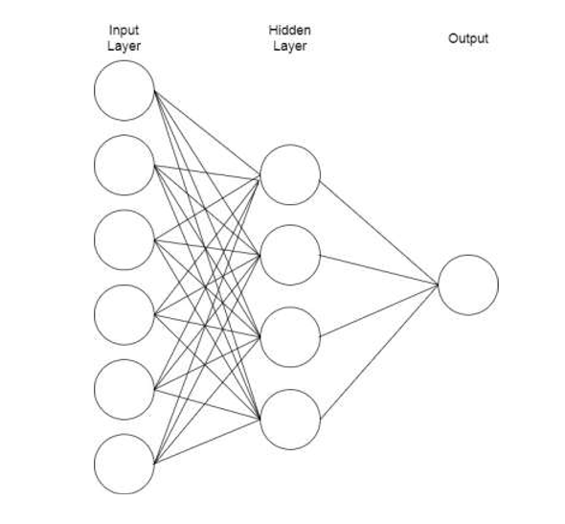
BLOCK DIAGRAMS
We use feedforward neural network which has a input layer with 6 neurons, a single hidden layer which has 4 neural neurons and a output layer with single neuron. The Backpropagation algorithm has been used for training the network.
Insert your desired
text here.
Insert your desired
text here.
Insert your desired
text here.

Slide 17
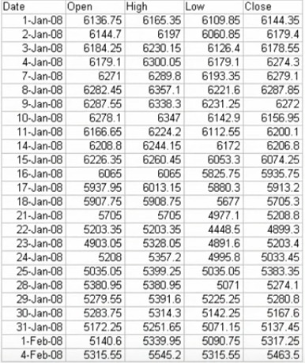
STOCK MARKET INPUT DATA FROM NEPSE

Slide 18
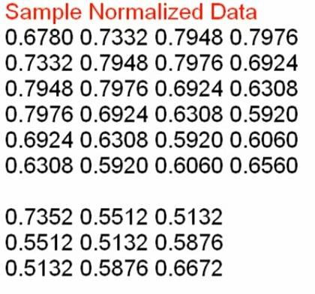
NORMALIZED INPUT DATA

Slide 19
DERIVERABLE TARGETS
After training the neural network, weights and bias are set accordingly to calculate the closing price. The network used as a feed forward network, which gives a certain output when given a set of inputs.
An input set like the one given below is given to the network.
0.2972972972973 0.0016617528812651 0.44117647058824 0.638720078125 0.28 0.292 0.2972972972973
The feed forward network then calculates an output according to the weights and bias of the individual neurons. The given input set generated an output as
0.6153274
The output normalized data is then converted into normal form by using reverse minmax formula

Slide 20
REFERENCES [1]R. Wilson and R. Sharda, "Bankruptcy prediction using neural networks", Decision Support Systems, vol. 11, no. 5, pp. 545-557, 1994. [2]Atsalakis, G. S., Dimitrakakis, E. M., & Zopounidis, C. D. (2011). Elliott wave theory and neuro-fuzzy systems, in stock market prediction: The WASP system. Expert Systems with Applications, 38, 9196–9206 [3]K. Tsai and J. Wang, "External technology sourcing and innovation performance in LMT sectors", Research Policy, vol. 38, no. 3, pp. 518-526, 2009. [4]K. Han and J. Kim, "Genetic quantum algorithm and its application to combinatorial optimization problem", Evolutionary Computation, 2000, vol. 2, pp. 1354-1360, 2000. [5]"Market Capitalisation Definition from Financial Times Lexicon", Lexicon.ft.com, 2016. [Online]. Available: http://lexicon.ft.com/Term?term=market-capitalisation. [Accessed: 10- Nov- 2016]. [6]"MarketTrak's Forecast Model Overview", Markettrak.com, 2016. [Online]. Available: http://www.markettrak.com/about.html. [Accessed: 25- Nov- 2016]. [7]S. Hannon, "5 Rules For Prediciting Stock Market Trends - StockTrader.com", StockTrader.com, 2016. [Online]. Available:https://www.stocktrader.com/2009/05/04/predicting-stock-market-trendsrules/. [Accessed: 16- Nov- 2016].

